Slide 1
Progress Update
2022. 11.08
송희수

Slide 2
Position matching
C1
C2
C3
C4
Average (C1, C2)
Average (C1, C2, C3)
Average
(C1, C2, C3, C4)
A little change in number of matching depending on the order of comparison
spot_position_matching.py

Slide 3
Position matching
Average position
Originalposition
n_match
id
sigma
intensity
 | x [nm] | y [nm] | n_match | C1_id | C2_id | C3_id | C4_id | C1_posX | C1_posY | C2_posX | C2_posY | C3_posX | C3_posY | C4_posX | C4_posY | C1_sigma | C2_sigma | C3_sigma | C4_sigma | C1_int | C2_int | C3_int | C4_int
0 | 70413.43 | 29361.61 | 4 | 1898 | 6475 | 11102 | 6454 | 70408.79 | 29361.89 | 70314.57 | 29322.05 | 70461.27 | 29354.05 | 70469.1 | 29408.45 | 67.64322 | 92.85496 | 102.5458 | 117.7266 | 4223.286 | 67899.97 | 71043.74 | 4337.783
1 | 68613.92 | 117442.5 | 4 | 1842 | 6320 | 10803 | 6235 | 68598.52 | 117416.5 | 68581.04 | 117505.7 | 68634.21 | 117431.9 | 68641.92 | 117416 | 114.9128 | 105.4847 | 103.0692 | 109.453 | 40365.79 | 75171.81 | 30114.2 | 7312.859
2 | 60063.92 | 102822 | 4 | 1610 | 5516 | 9346 | 5166 | 60043.29 | 102756.8 | 60080.03 | 102833.6 | 60148.46 | 102841.7 | 59983.88 | 102855.9 | 103.5012 | 100.5116 | 145.9077 | 102.6879 | 8621.778 | 44651.59 | 240188.1 | 2739.432
3 | 10473.53 | 109934 | 3 |  | 811 | 1344 | 547 |  |  | 10415.32 | 109848.8 | 10449.6 | 109992.7 | 10555.68 | 109960.6 |  | 115.2587 | 136.4612 | 95.28513 |  | 120311.3 | 39924.22 | 3036.351
4 | 49826.21 | 3194.902 | 3 |  | 4516 | 7604 | 4039 |  |  | 49858 | 3099.18 | 49852.92 | 3214.834 | 49767.71 | 3270.691 |  | 117.413 | 153.5886 | 138.0196 |  | 24342.42 | 51890.68 | 4670.267
5 | 108875.8 | 50506.13 | 3 |  | 9917 | 17235 | 11471 |  |  | 108928.8 | 50456.73 | 108788 | 50497.93 | 108910.4 | 50563.73 |  | 121.0816 | 104.8823 | 125.9989 |  | 39808.71 | 23803.03 | 11978.28
6 | 25636.08 | 96375.33 | 3 |  | 2188 | 3640 | 1647 |  |  | 25638.33 | 96410.58 | 25681.88 | 96408.44 | 25588.02 | 96306.98 |  | 103.1734 | 122.1552 | 118.4435 |  | 53421.94 | 68577.48 | 7376.229
7 | 22829.29 | 111440.7 | 3 | 550 |  | 3171 | 1411 | 22869.99 | 111492.5 |  |  | 22772.44 | 111431.3 | 22845.45 | 111398.4 | 128.695 |  | 159.7321 | 162.4909 | 8624.633 |  | 50984.04 | 11108.85
8 | 43758.39 | 124712.9 | 3 | 1153 | 3910 | 6612 |  | 43692.99 | 124643.2 | 43758.87 | 124752.5 | 43823.31 | 124742.9 |  |  | 128.7607 | 157.6818 | 111.1091 |  | 12343.29 | 40819.13 | 18941.46
9 | 62053.8 | 87230.17 | 3 |  | 5689 | 9647 | 5413 |  |  | 62034.21 | 87257.36 | 62018.59 | 87161.75 | 62108.61 | 87271.4 |  | 92.41585 | 110.802 | 137.0963 |  | 23103.33 | 68939.23 | 34251.27
10 | 55443.62 | 90332.12 | 3 | 1470 | 5049 |  | 4650 | 55399.09 | 90359.4 | 55457.22 | 90305.7 |  |  | 55474.54 | 90331.26 | 168.9955 | 101.3973 |  | 155.9369 | 19863 | 32380.68 |  | 20068.74
11 | 76346.97 | 55166.94 | 3 |  | 7047 | 12086 | 7199 |  |  | 76386.04 | 55152.83 | 76303.69 | 55101 | 76351.19 | 55246.98 |  | 113.3855 | 140.5573 | 141.4293 |  | 241879.7 | 972647.2 | 82223.85
12 | 22686.48 | 53475.94 | 3 | 541 | 1915 | 3166 |  | 22676.29 | 53434.91 | 22629.73 | 53481.2 | 22753.43 | 53511.72 |  |  | 78.86632 | 88.62951 | 104.8255 |  | 3866.677 | 56575.91 | 162165.4

Slide 4
Filling in Missing Values
Missing values in data frame cause errors or limitations in computing clusters and downstream analysis
Sigma
Fill in with 0 [nm]
Intensity
Average background signal (bkgstd [photon]) for each channel.
Maybe not much different from setting it to 0 but reflect channel specific information.
spot_position_matching.py

Slide 5
Cluster Analysis
Variables Used: Sigma and Intensity (C1, C2, C3, C4)
Normalization
Calculate distance (Euclidean distance)
Determine optimal number of clusters
Dendrogram (hierarchical clustering)
Average Silhouette coefficient
Plot clusters
spot_clustering.R

Slide 6
Evaluate Clusters
Number of spots in each cluster
The proportion of cluster in each channel
The proportion of cluster in each match number (1~4)
Mean sigma & intensity values in each cluster
spot_clustering.R

Slide 7
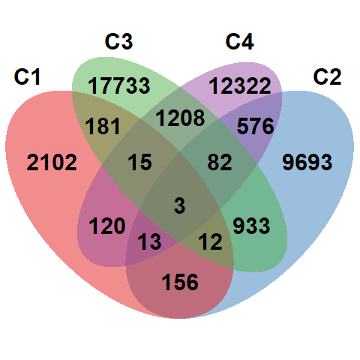
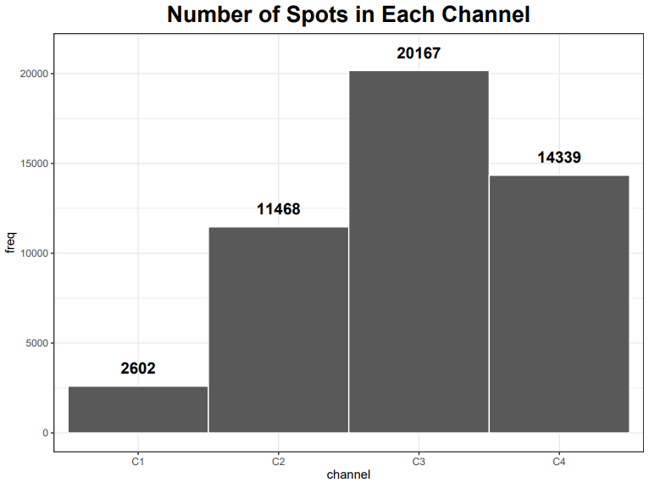
Explore Data (Patient Sample)

Slide 8
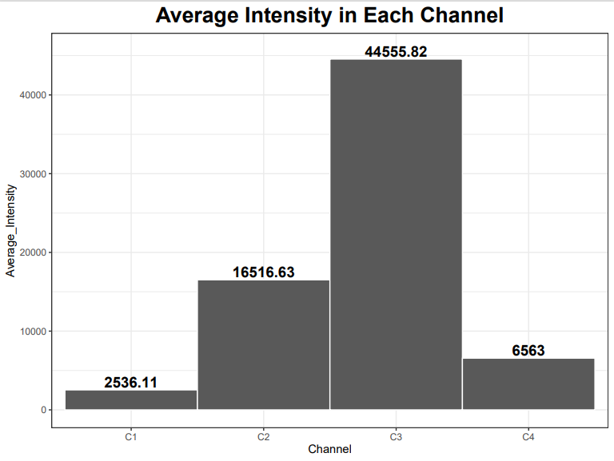
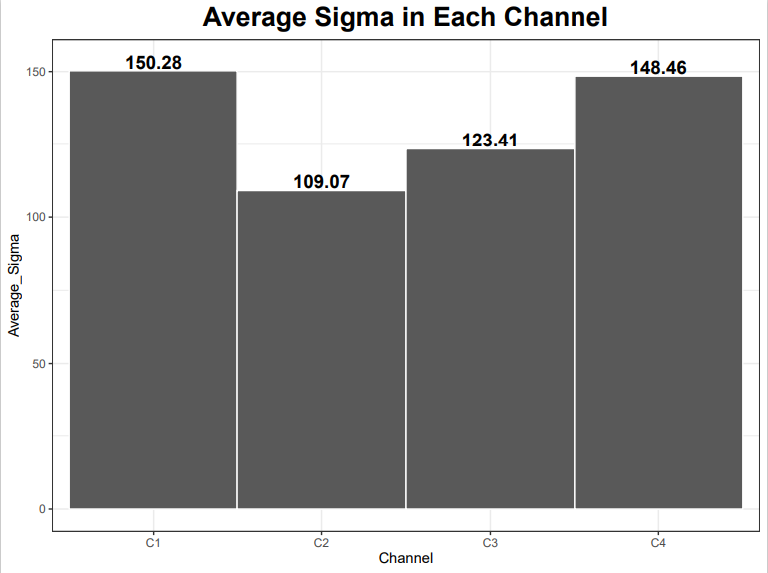
Explore Data (Patient Sample)

Slide 9
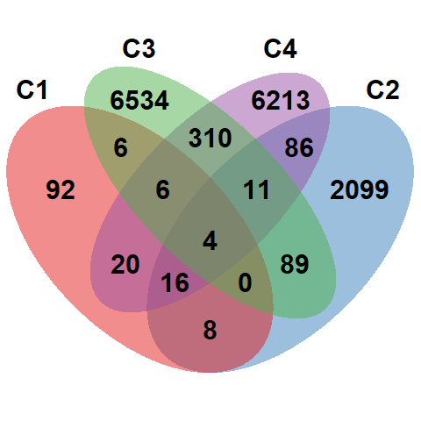
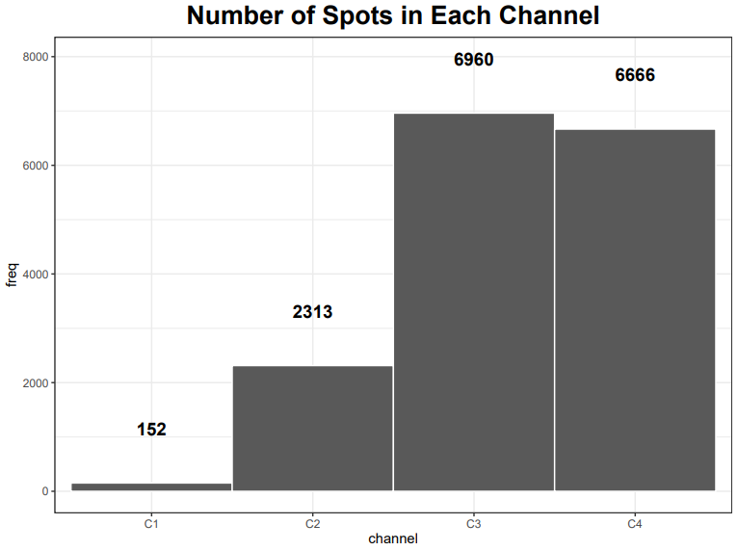
Explore Data (Benign Sample)

Slide 10
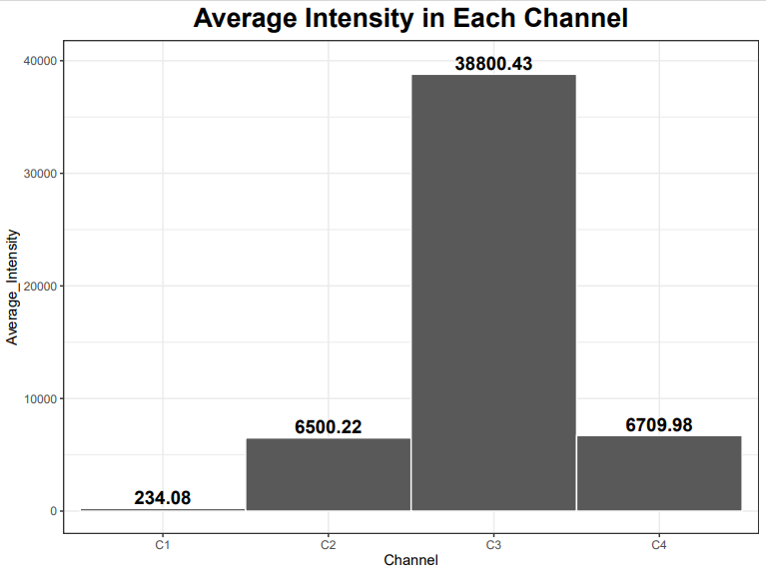
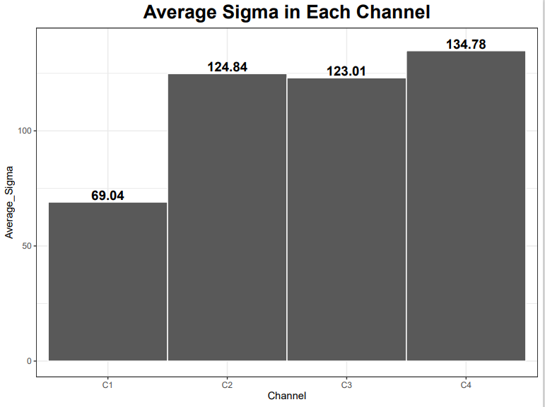
Explore Data (Benign Sample)

Slide 11
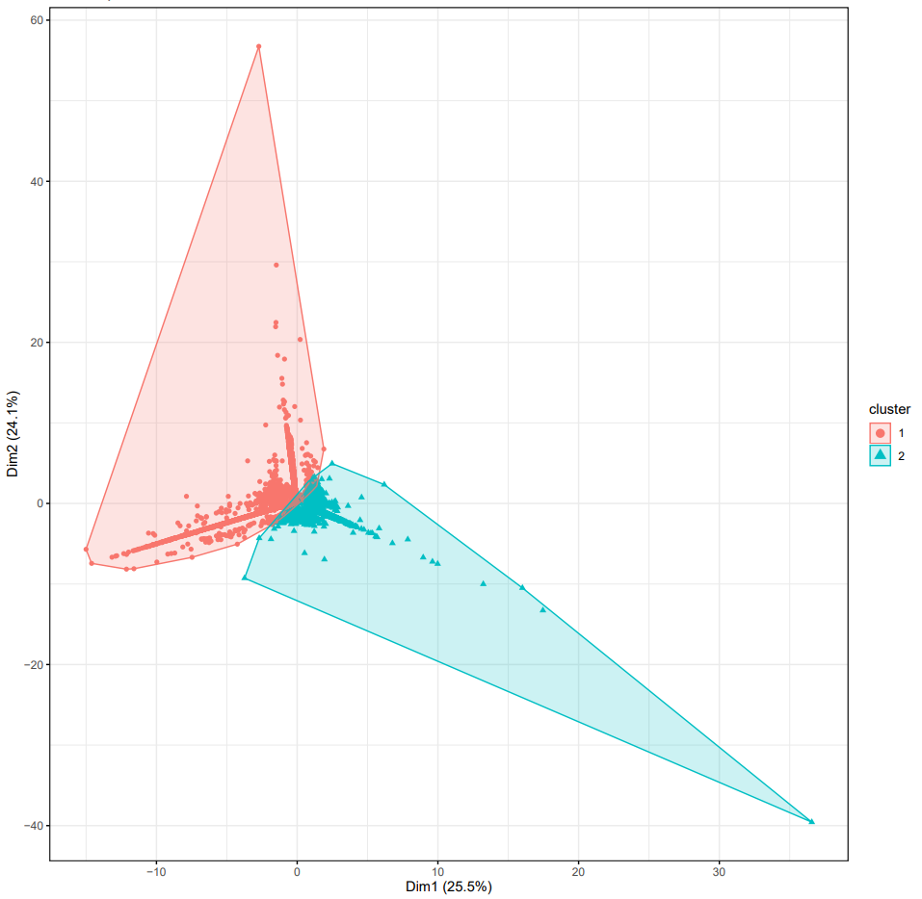
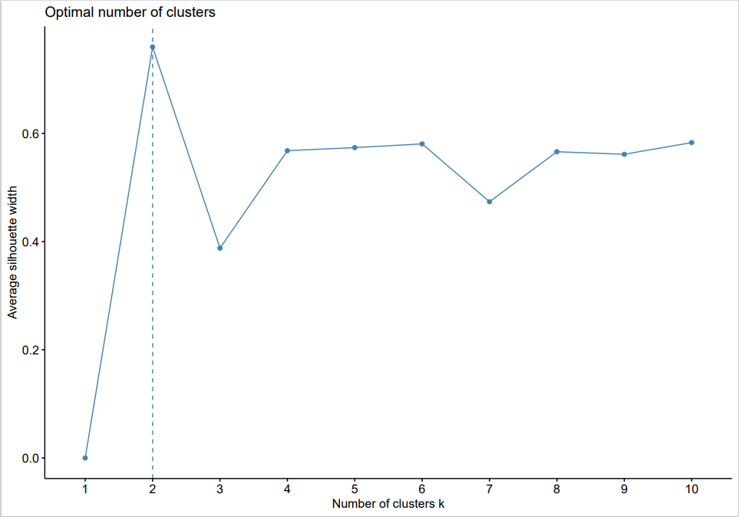
Cluster Analysis (Patient Sample)
Average silhouette coefficient
C1, C2, C4
C3

Slide 12
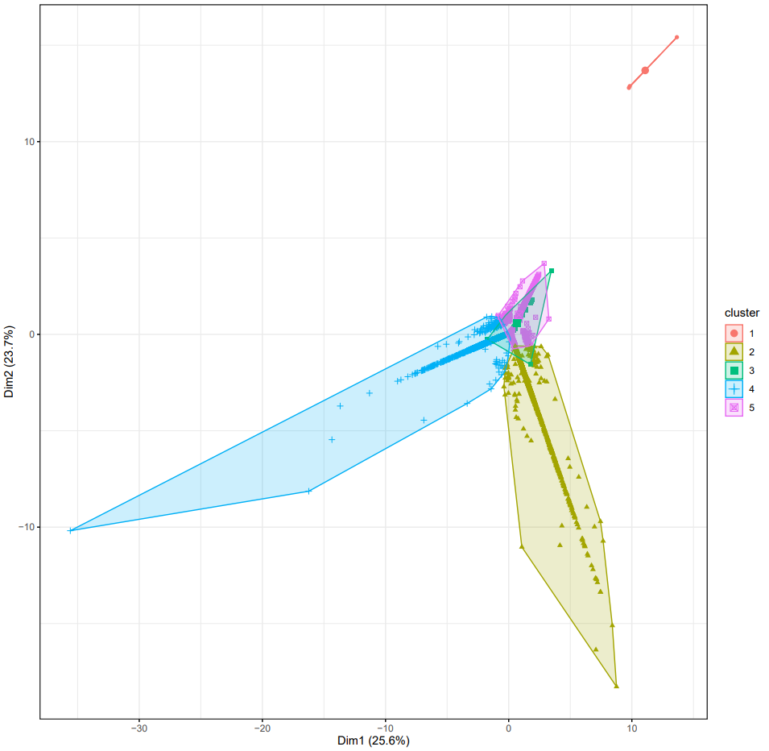
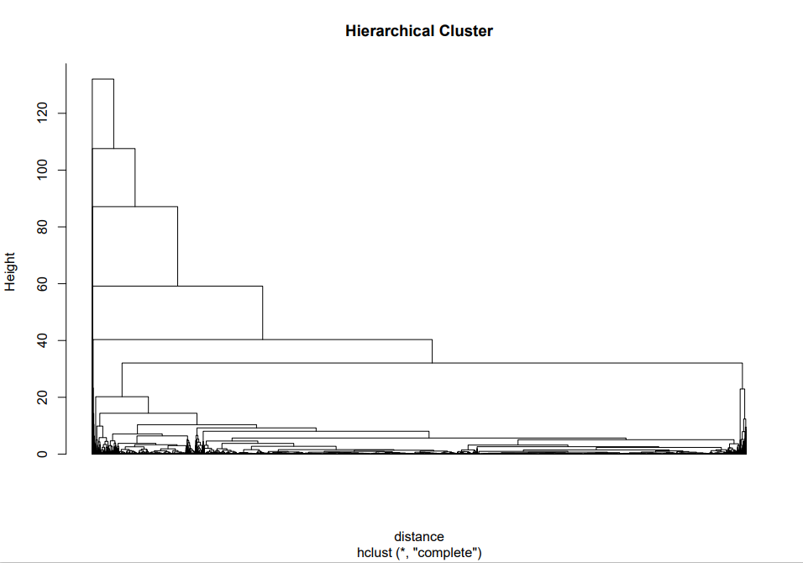
Cluster Analysis (Benign Sample)
Dendrogram
Notes:
세 방향으로 뻗음. 일직선 아닌 것들이 matching spots일 것

Slide 13
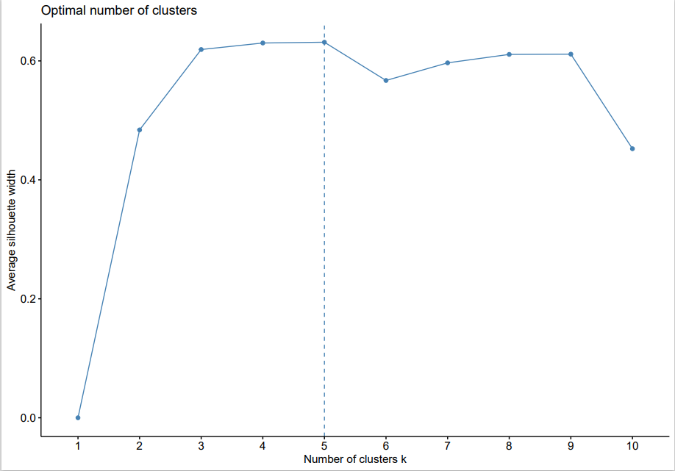
Cluster Analysis (Benign Sample)
Notes:
세 방향으로 뻗음. 일직선 아닌 것들이 matching spots일 것

Slide 14
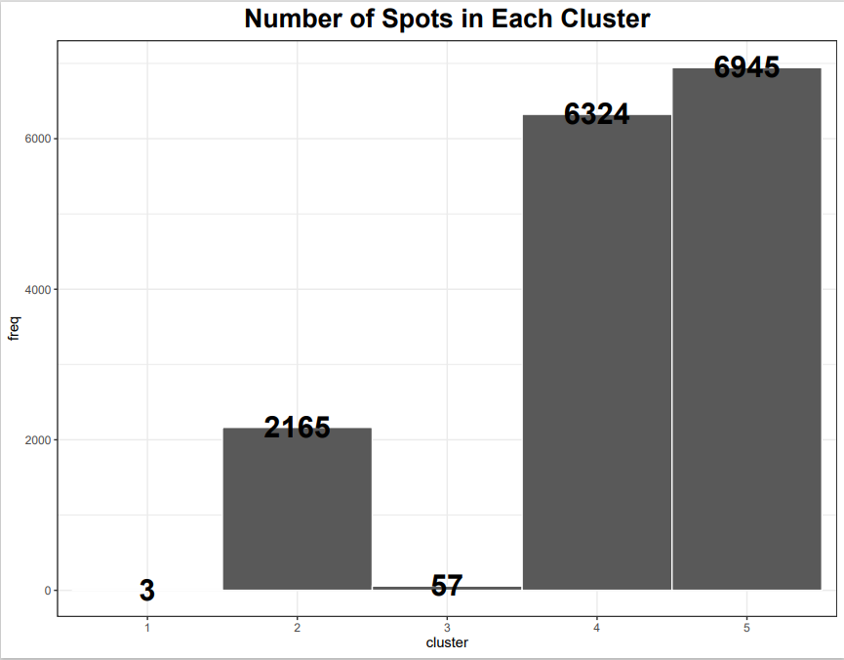
Evaluate Clusters (Benign Sample)

Slide 15
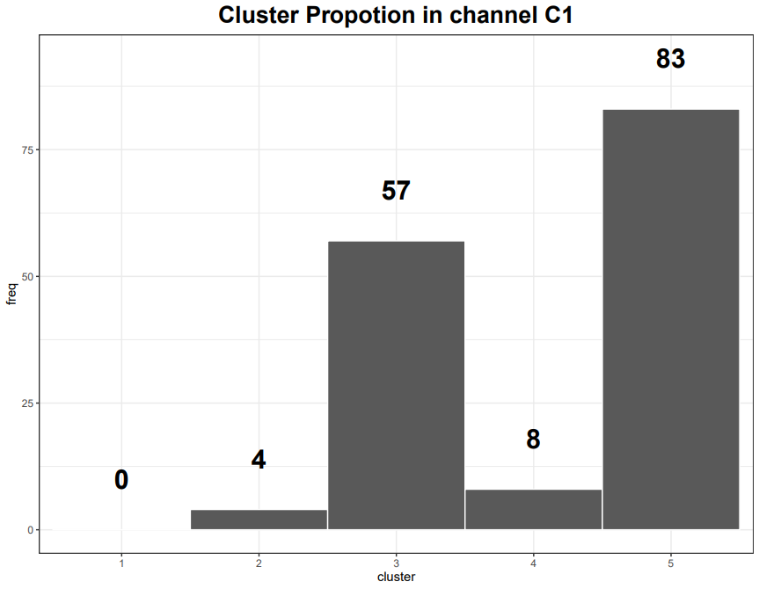
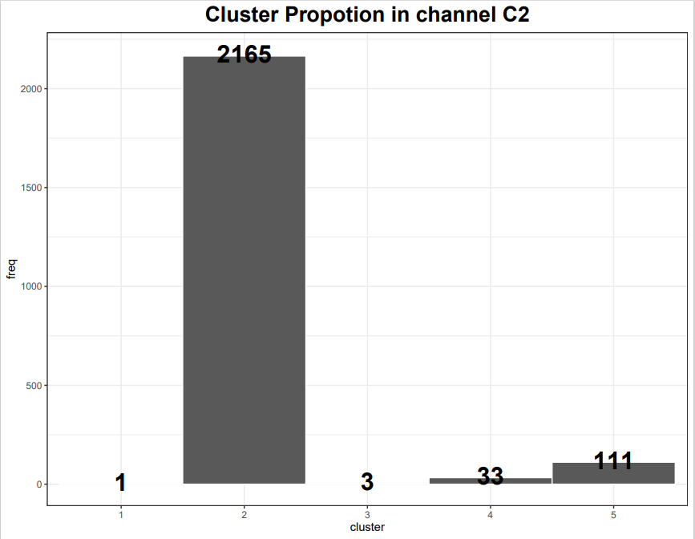
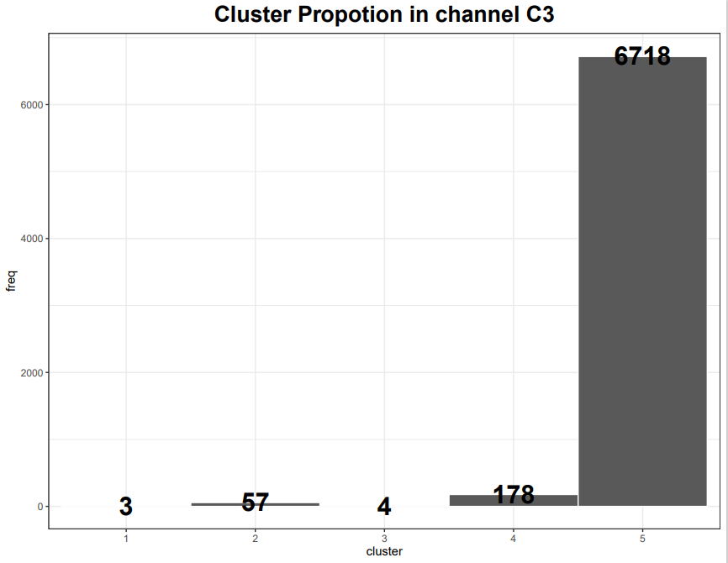
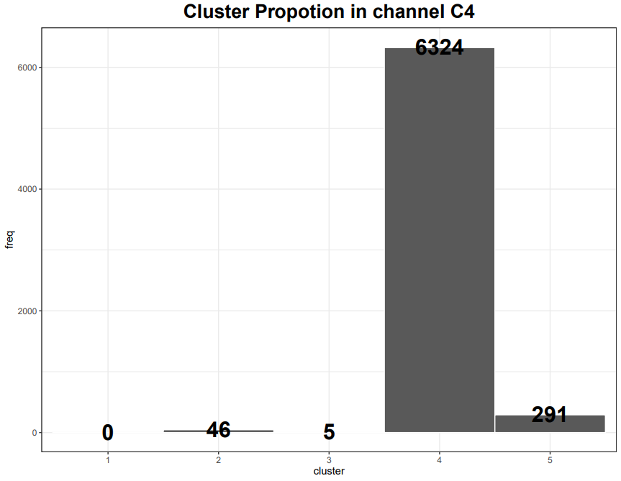
Evaluate Clusters (Benign Sample)

Slide 16
Evaluate Clusters (Benign Sample)
Possibly outlier (dust, etc.)
C3
C1
C4
C2
가능성:
일직선상에 있는 것들은 겹치지 않는 spot들.
그 외 = matching spots

Slide 17

Evaluate Clusters (Benign Sample)

Slide 18
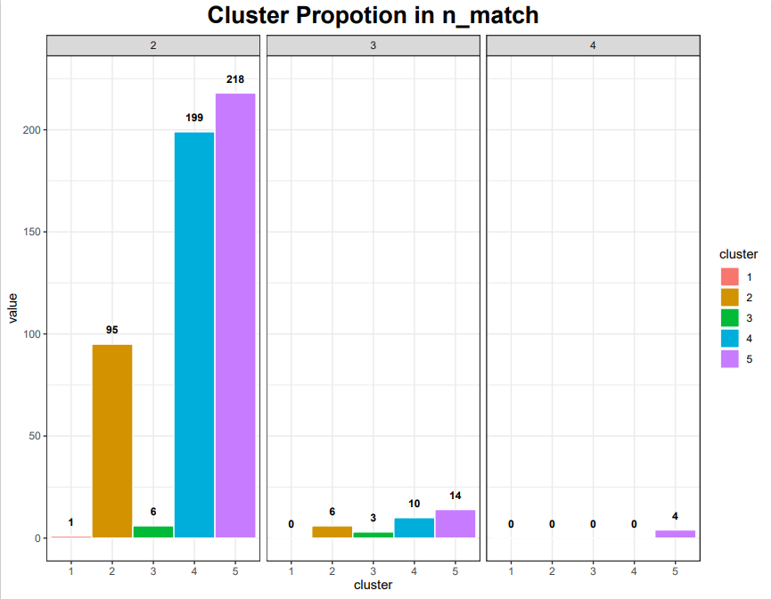
Evaluate Clusters (Benign Sample)

Slide 19
To do
Cluster analysis without unmatched spots
Try different distance/clustering parameters
채널 별 expression 개수 벤다이어그램
Intensity 별 histogram
Microarray digitizing (이규상 박사님과)
쓸 만한 이미지인지 감별하는 standard

